Slide 1
CS3241 Computer Graphics
Assignment 5
District CG

Slide 2
Assignment 5, Textures
Create your own building
Can be a house/farm/school/church/temple stadium etc.
Basically anything that can be easily textured
Construct your building within wireframe cuboid
Play with the sample file inside the “Texture” folder

Slide 3
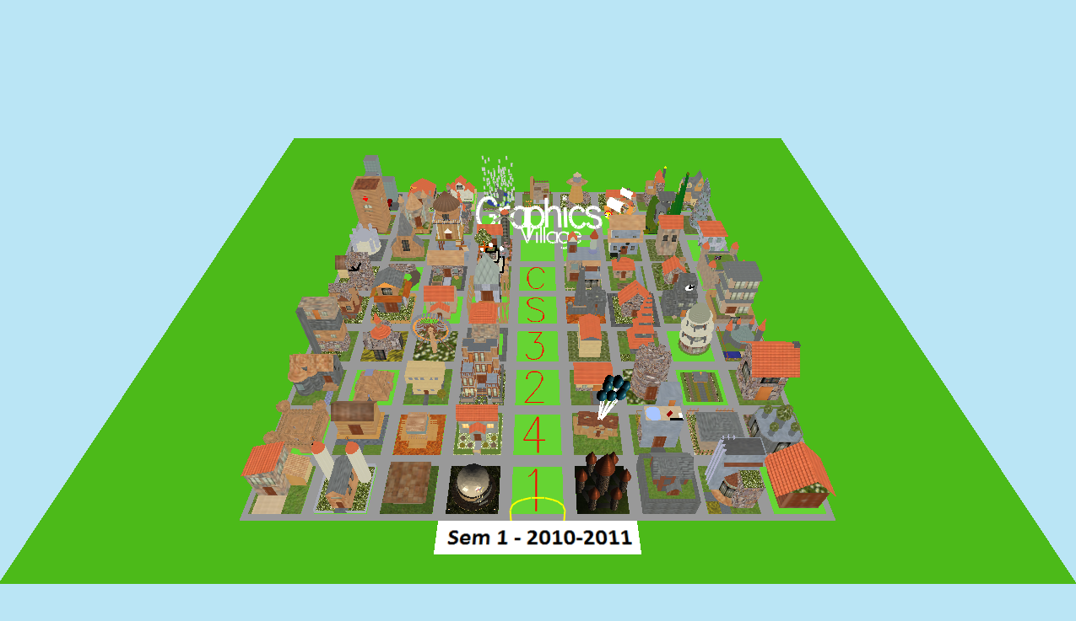

Slide 4
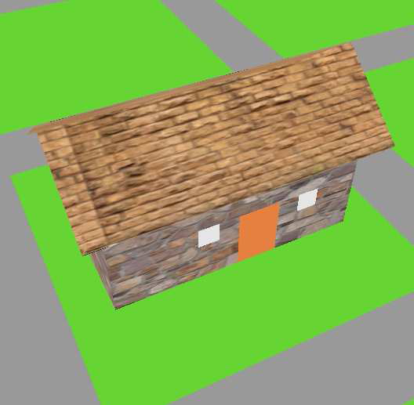
Construction
-4<x<4
0<y<12
-4<z<4

Slide 5
Implementation
Enable texture mapping (disable after drawing)
glEnable(GL_TEXTURE_2D);
Bind desired texture
glBindTexture( GL_TEXTURE_2D, texSet[0] );
Define texture coordinates
glBegin(GL_QUADS);
glTexCoord2d(0.0,0.0);glVertex3f(-3, 0, -1.5);
glTexCoord2d(1.0,0.0);glVertex3f(3, 0, -1.5);
glTexCoord2d(1.0,1.0);glVertex3f(3, 3, -1.5);
glTexCoord2d(0.0,1.0);glVertex3f(-3, 3, -1.5);
glEnd();

Slide 6
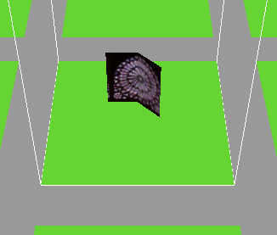
Practice exercise
Draw a wall folded in the center

Slide 7
Ex1
glEnable(GL_TEXTURE_2D);
//…
glBindTexture(GL_TEXTURE_2D, texSet[29]);
glBegin(GL_QUADS);
glTexCoord2d(0,0);glVertex3f(-1.4, 0, -1);
glTexCoord2d(0.5,0);glVertex3f(0, 0, -1);
glTexCoord2d(0.5,1);glVertex3f(0, 3, -1);
glTexCoord2d(0,1);glVertex3f(-1.4, 3, -1);
glEnd();
glBegin(GL_QUADS);
glTexCoord2d(0.5,0);glVertex3f(0, 0, -1);
glTexCoord2d(1,0);glVertex3f(1, 0, 0);
glTexCoord2d(1,1);glVertex3f(1, 3, 0);
glTexCoord2d(0.5,1);glVertex3f(0, 3, -1);
glEnd();
//…
glDisable(GL_TEXTURE_2D);

Slide 8
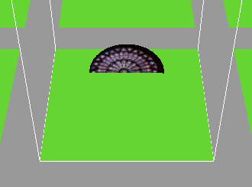
Practice exercise
Draw a half circle

Slide 9
Ex2
float degInRad, radius=2;
const float DEG2RAD = 3.14159/180;
glBindTexture(GL_TEXTURE_2D, texSet[29]);
glBegin(GL_POLYGON);
for(int i=0;i<180;++i){
degInRad = i*DEG2RAD;
glTexCoord2d(cos(degInRad)/2+0.6,
sin(degInRad)/2+0.5);
glVertex3f(cos(degInRad)*radius,
sin(degInRad)*radius,-2);
}
glEnd();

Slide 10
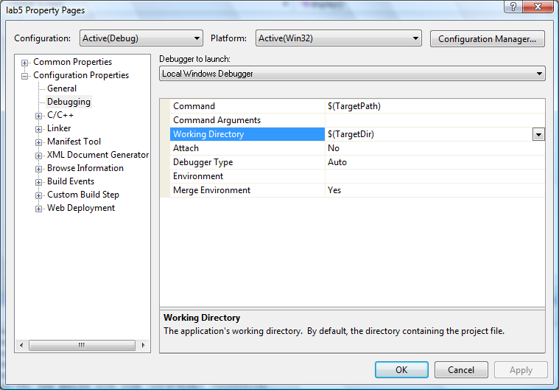
Running Problems

Slide 11
Frame rate requirement
At least 100 frames per second.

Slide 12
Points to note
Submit ONLY lab5.cpp
Post your screenshot onto FB for voting
Rename all your functions into
e.g. U087654DrawMyHouse instead of drawMyHouse
Only use the textures provided
Cannot add your own!
Ignore the “x.bmp” and “water0.bmp”

